Slide 1


Visveswaraya Technological University
Belagavi – 590018
Ghousia College Of Engineering
Ramanagaram, Karnataka 562159
A Project based on “Covid-19 Test Samples analysis using Python
Prepared by:
NAME | USN
Md REZABUL | 1GC21EE004
CHAITHANYA M B | 1GC21EE001
KEERTHANA K G | 1GC21EE003
Under the guidence of:
Lathamani ma'am
Asst. Prof.
Dept. Of EEE

Slide 2
Introduction
Purpose: To analyse statewise COVID-19 testing data.
Dataset: "Statewise Testing details.csv" containing data on total samples, positive, and negative cases.
Analysis Tools: Python (Pandas, Matplotlib, Seaborn).

Slide 3
Dataset Overview
Date: 17-04-2020 to 10-08-2021
Total Samples
Data Size: 16,336 entries
Total Samples: 16,336
Positive: 5,662
Negative: 6,969
Data Types: Object, Float

Slide 4
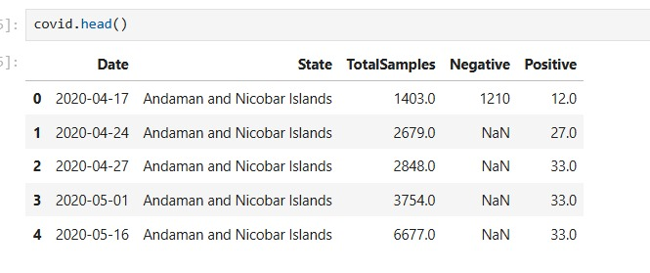
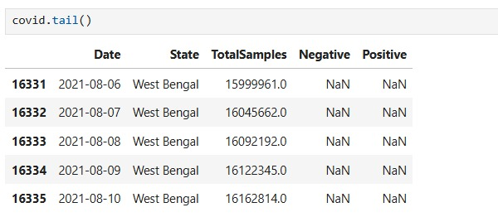
Initial Data Insights
First Five Rows of the Dataset:
Last Five Rows of the Dataset:

Slide 5
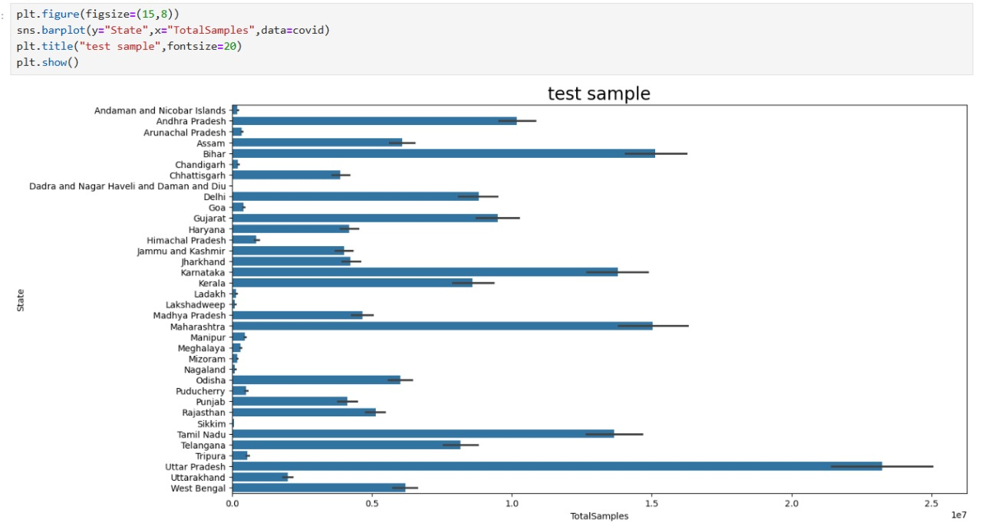
TEST SAMPLES BY STATES

Slide 6
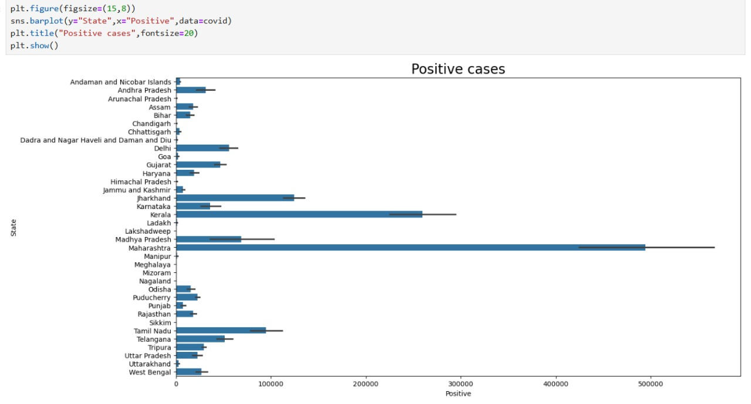
Positive Cases by StateS
Visualization:
Bar plot showing positive cases for all states.
Code Snippet:
plt.figure(figsize=(15,8))
sns.barplot(y="State", x="Positive",data=covid)
plt.title("Positive cases", fontsize=20)
plt.show()

Slide 7
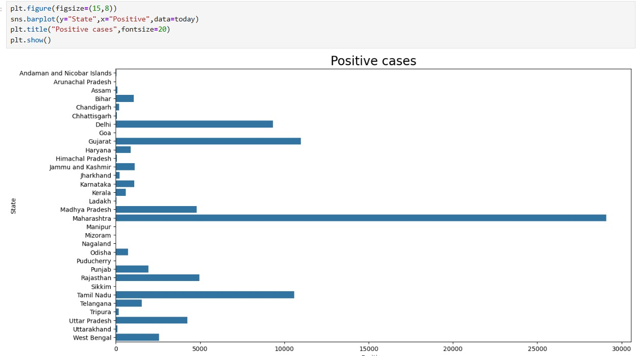
Data on May 16, 2020
Data Filter: today = covid[covid.Date=='2020-05-16’]
Visualization
Bar plot: Positive cases by state for May 16, 2020.

Slide 8
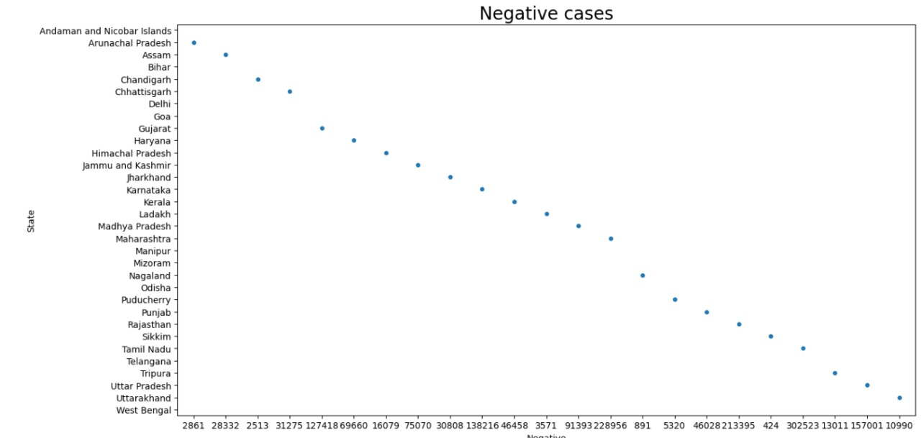
Negative Cases on May 16, 2020
Visualization:
Strip plot showing negative cases by state
Code Snippet:
sns.stripplot(y="State", x="Negative", data=today)
plt.title("Negative cases", fontsize=20)
plt.show()

Slide 9
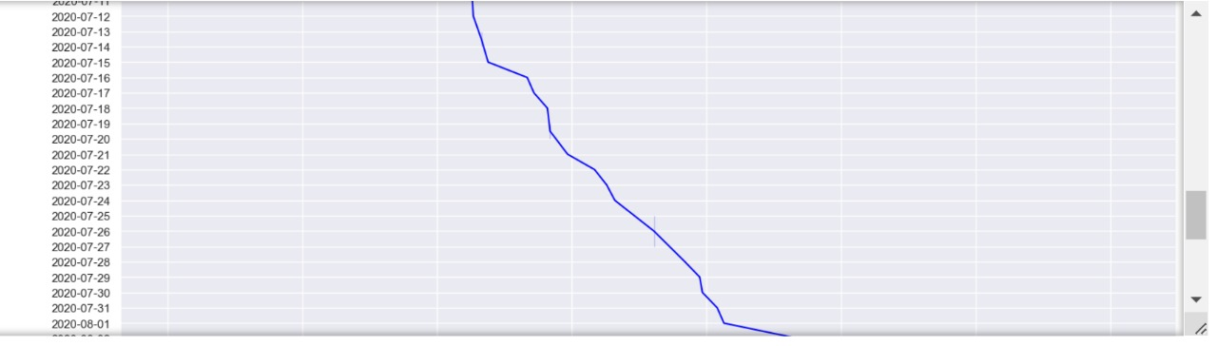

State-Specific Insights (Mizoram)
Mizoram Data:
Entries: 465
Positive Cases: 125
Scatter Plot: Positive cases over time

Slide 10
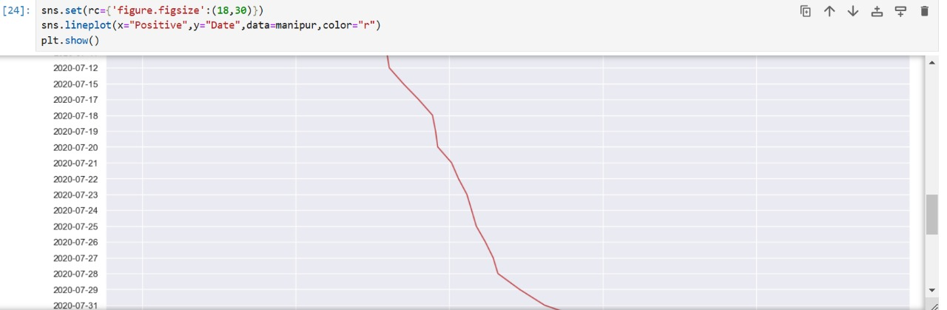
State-Specific Insights (Manipur)
Manipur Data:
Entries: 406
Positive Cases: 80
Line Plots: Positive cases over time.

Slide 11
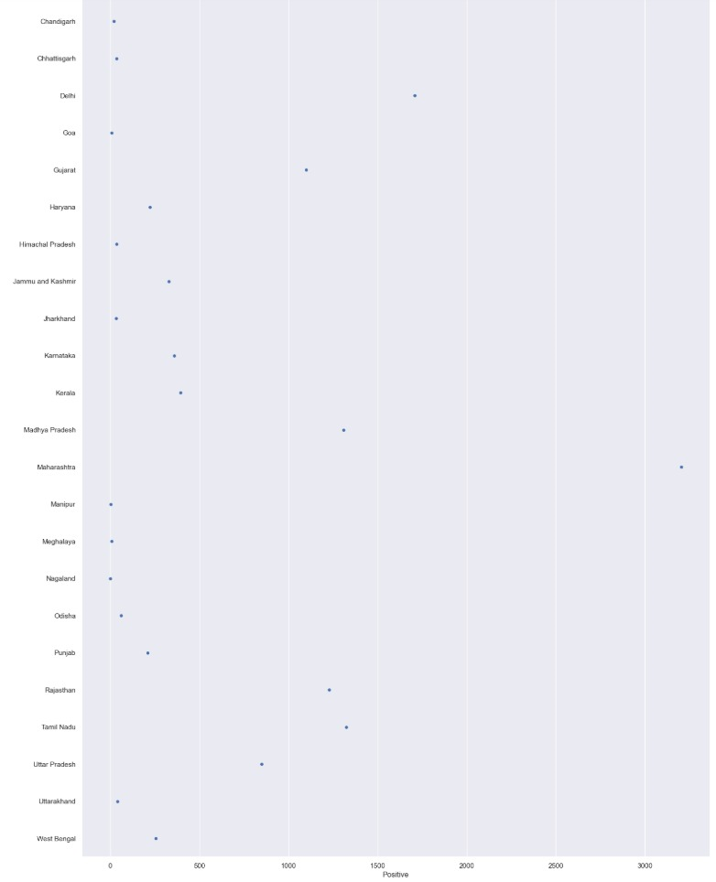
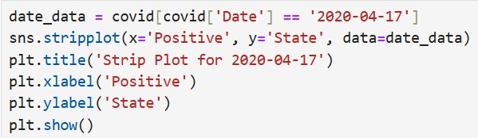
April 17, 2020 Data
Filter: data=covid[covid.Date=='2020-04-17’]
Visualization:Strip plot

Slide 12
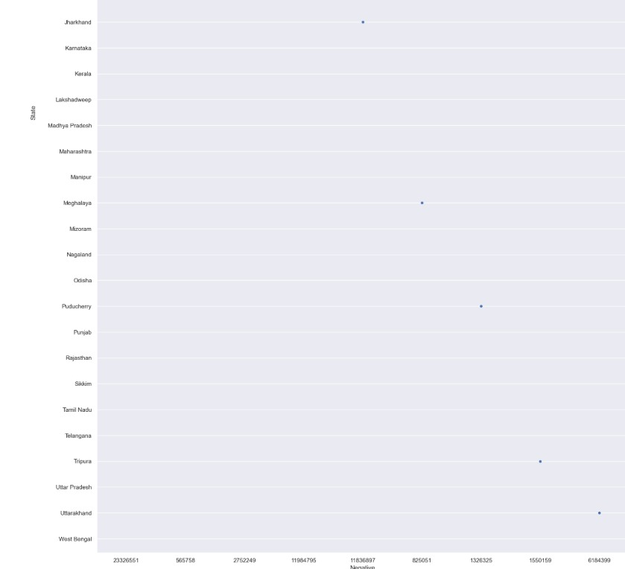
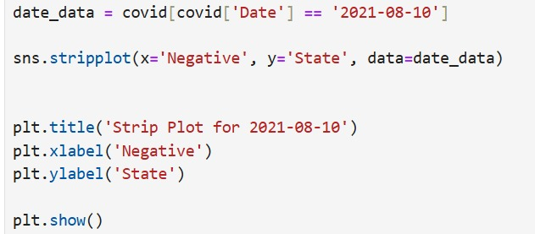
August 10, 2021 Data

Slide 13
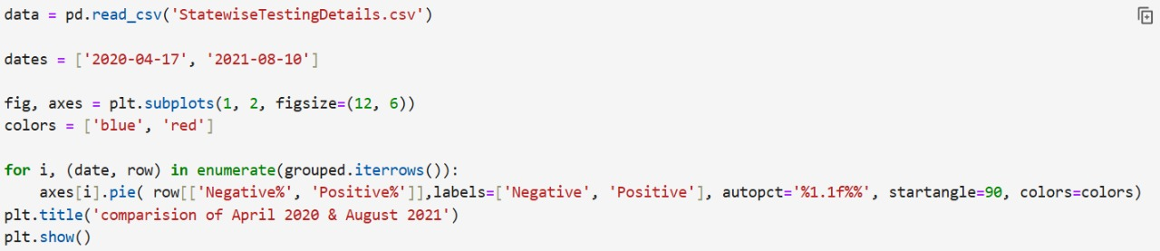
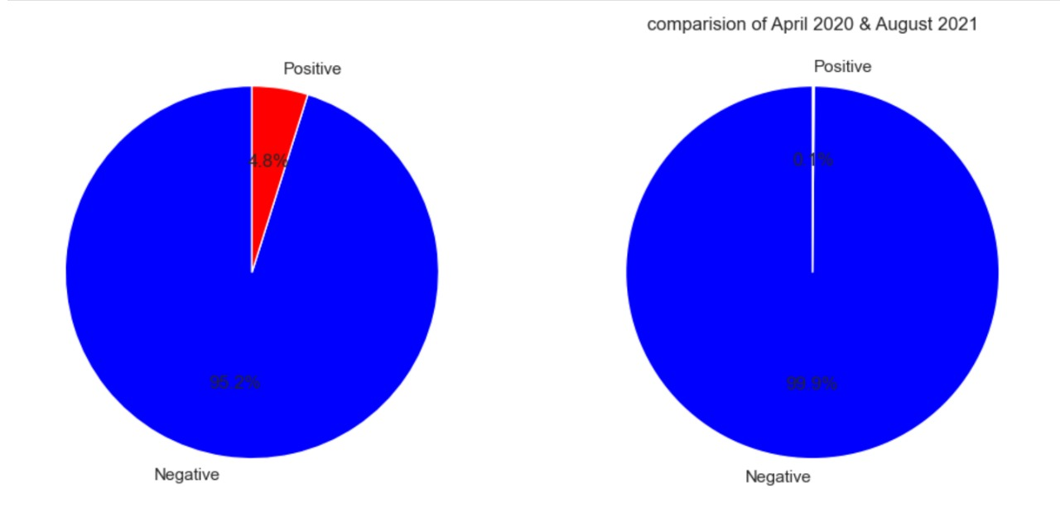
Comparison of Positive vs Negative Cases (April 17, 2020)&(august 10, 2021)

Slide 14
conclusion
This analysis provided a clear understanding of COVID-19 testing data across states. We visualized the distribution of test samples, positive cases, and negative cases, both overall and on specific dates like May 16, 2020. The results highlight significant differences between states in terms of testing and case outcomes.
Through Python libraries like Pandas, Matplotlib, and Seaborn, we efficiently explored and visualized the data. This project demonstrates how data analysis can help identify trends and support informed decision-making during critical times like a pandemic.

Slide 15
Future Scope
Data Gaps:
Missing values in Negative and Positive columns.
Possible Analysis: Predictive modeling for case trends.
Correlation studies with external factors.

Slide 16
THANKYOU

